Slide 1

“Machine Learning and Artificial Neural Networks”
“Erol Kazancli”
Mint-Labs internal meeting
17 - March - 2017

Slide 2
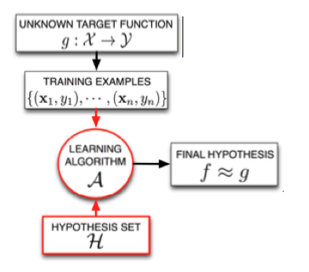
“Machine Learning”
Machine Learning:
The field that studies how to make computer learn
from data without being explicitly programming them
Key elements of machine learning:
There is a pattern
We cannot pin it down mathematically
We have data

Slide 3
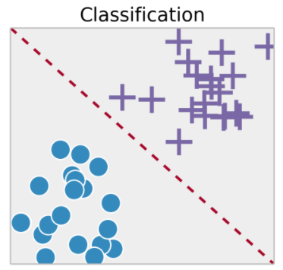
“Supervised Learning”
Supervised Learning: Learning from labeled data
Independent variables (features, attributes, dimensions):
x1: age, x2: gender, x3: income, x4: amount of debt, etc…
Dependent variable (target, outcome, response, label):
y: Creditworthiness (0: Not creditworthy 1: Creditworthy)
Credit Score (A real number)
We want to find a mapping between the independent
attributes (x1, x2,..., xn) and the dependent attribute y.

Slide 4
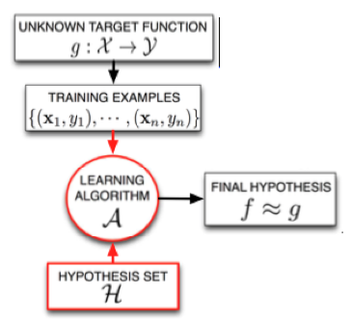

“Supervised Learning”
Hypothesis: A model that maps from the input data to
the output label.
e.g. f: R^{d} -> R. e.g. y = 0.5x₁ + 2x₂ – 0.9x₃ + 4
Hypotheses set: The set of hypotheses from among
which the hypothesis is obtained. e.g. the set of all
linear models y = w₁x₁ + w₂x₂ + w₃x₃ + w₀
Learning algorithm: The process for selecting the most
appropriate hypothesis from the hypotheses set.
e.g. Gradient Descent
Cost function: The criterion that guides the learning
process. e.g.

Slide 5
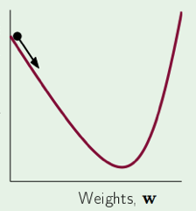


“Supervised Learning”
Learning:
The learning algorithm tries to minimize this cost
function.
Weights are updated in the opposite direction of the
derivative.

Slide 6
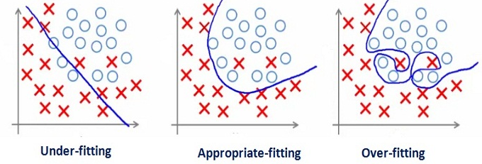
“Underfitting and Overfitting”

Slide 7
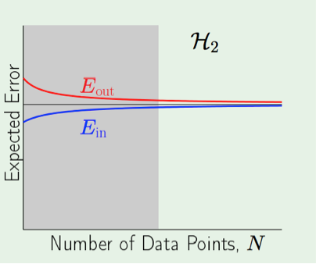
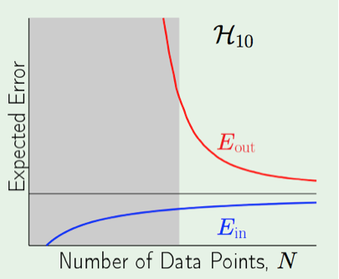
“Underfitting and Overfitting”
E_{in}= Training Error
E_{out}= Generalization Error

Slide 8
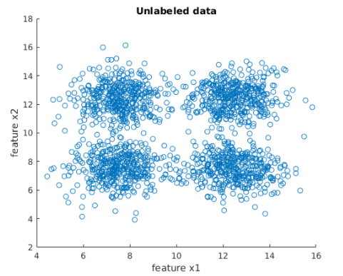
“Unsupervised Learning”
Unsupervised Learning: Learning from unlabeled data
Independent variables (features, attributes, dimensions):
x1: age, x2: gender, x3: income, x4: amount of debt, etc…
Dependent variable : No dependent variable
We want to discover an interesting pattern among
the data we have.

Slide 9
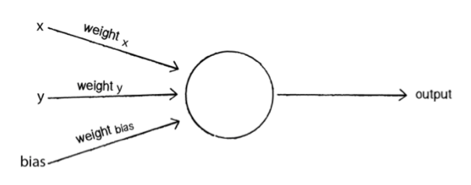
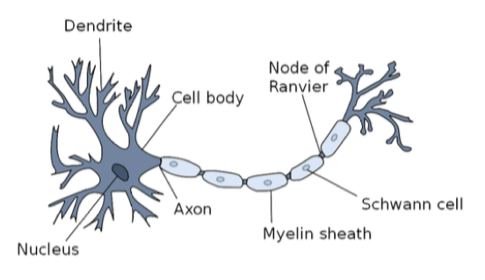
“Neural Networks - Perceptron”
Simplest artificial neural network
Inspired from nature
Building block of other more complex
ANNs
Features are multiplied by weights and
summed up which is in return fed to an
Activation function to produce a response

Slide 10
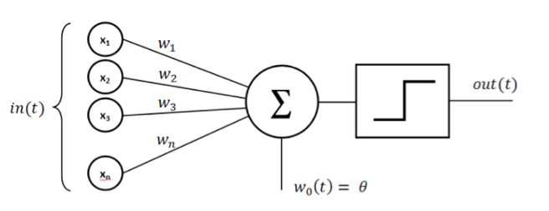
“Neural Networks - Perceptron”

Slide 11
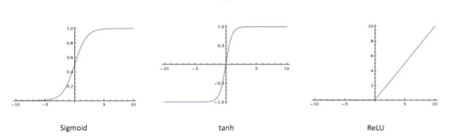
“Neural Networks - Perceptron”

Slide 12
“Neural Networks - Perceptron”
Learning with Perceptron:
Initialize the weights
Classify all the training input according to this initial model
Find a misclassified example
Update the weight adding the misclassified input times the real output to the weight.
Return to step 1 and repeat until all the examples are correctly classified

Slide 13
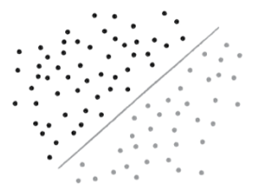
“Neural Networks - Perceptron”
With perceptron we can only solve linearly separable problems.

Slide 14
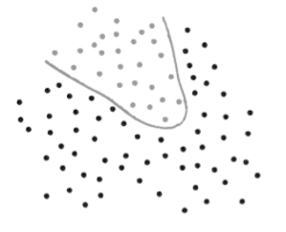
“Neural Networks - Perceptron”
What if we have a non-linear model?

Slide 15
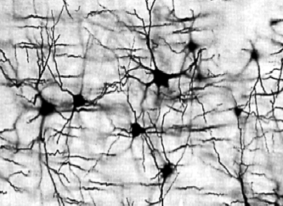
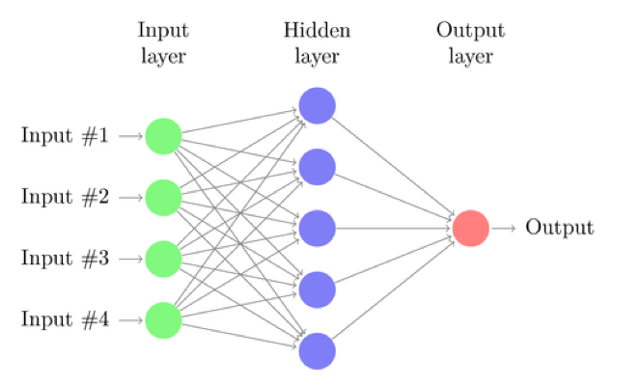
“Neural Networks – Multi-Layer Perceptron”
What if we have a non-linear model? Use multi-Layer Perceptron

Slide 16
“Neural Networks – Multi-Layer Perceptron”
Collection of multiple neurons, inspired by nature.
Has multiple layers.
Neurons in one layer is connected to all the neurons in the next layer.
Information is fed forward from inputs to the outputs.

Slide 17
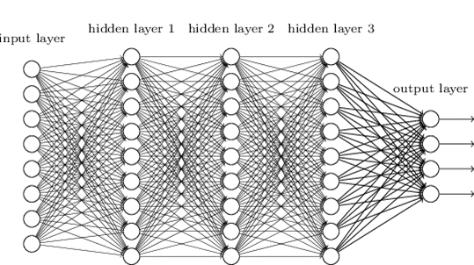
“Neural Networks – Multi-Layer Perceptron”

Slide 18
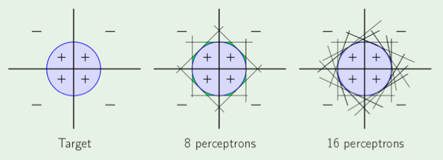
“Neural Networks – Multi-Layer Perceptron”

Slide 19
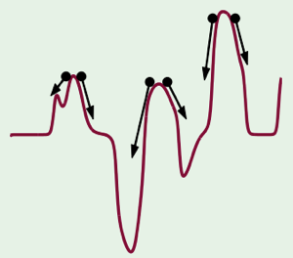
“Neural Networks – Multi-Layer Perceptron”
Learning in Multilayer Perceptrons:
Initialize the weights.
Feedforward all the inputs to obtain a
classification for each data point.
Calculate the error.
Update the weight by backpropagation algorithm
(backpropagating the derivatives wtr each weight)
5. Return to step 1 and repeat until certain accuracy
level is reached or after a certain number of iterations

Slide 20
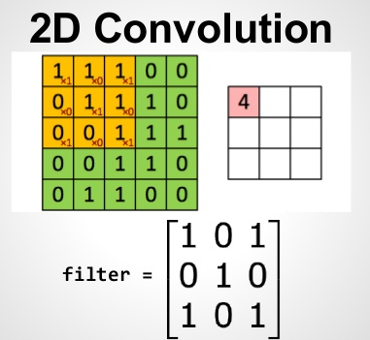
“Neural Networks – Convolutional Neural Networks”
Filters:
Used to smooth images or
detect structures.
Consists of weigths which are multiplied by
the corresponding element, the results is
summed up.
Applied gen. to 2D or 3D data such as
images.
Applied in a sliding window fashion.

Slide 21
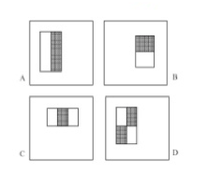
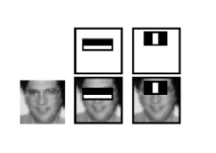
“Neural Networks – Convolutional Neural Networks”
Filters:
Used to smooth images or
detect structures.
Consists of weigths which are multiplied by
the corresponding element, the results is
summed up.
Applied gen. to 2D or 3D data such as
images.
Applied in a sliding window fashion.

Slide 22
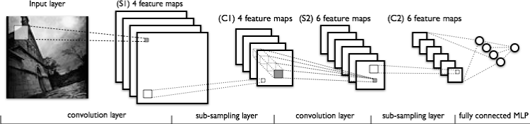
“Neural Networks – Convolutional Neural Networks”

Slide 23
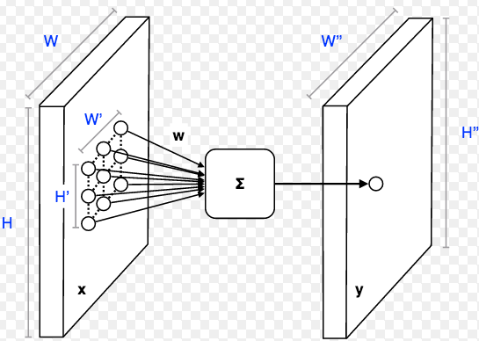
“Neural Networks – Convolutional Neural Networks”

Slide 24
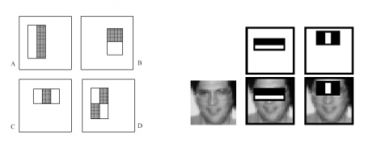
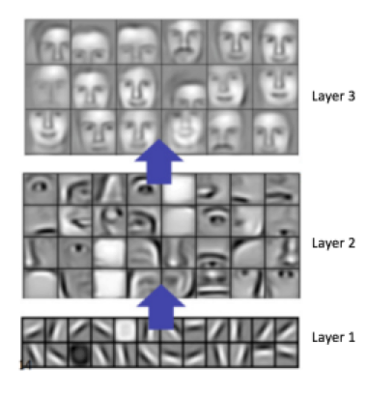
“Neural Networks – Convolutional Neural Networks”
Pre-designed filters: CNN Learned Filters:

Slide 25
“Neural Network Applications”
Pattern Recognition: Object Recognition in an image
Time Series Prediction: Stock price prediction, weather prediction
Signal Processing: Process audio signal to filter out the noise
Control: Self-driving cars
Anomaly Detection: Fraud detection

Slide 26
THANK YOU!

